Slide 1



www.groundgurus.com

Slide 2
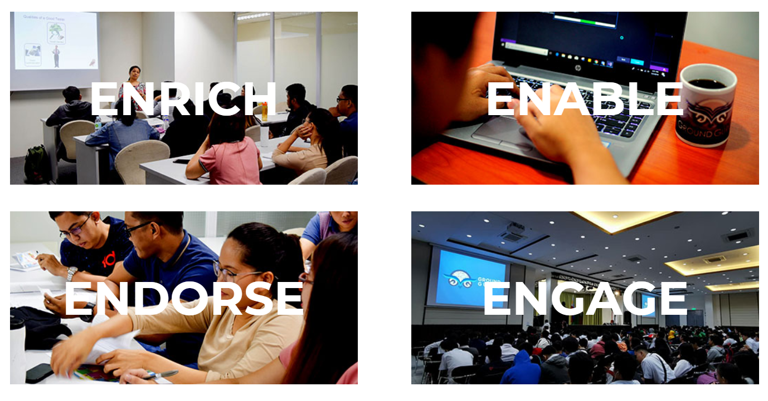

Slide 3


Slide 4






Slide 5
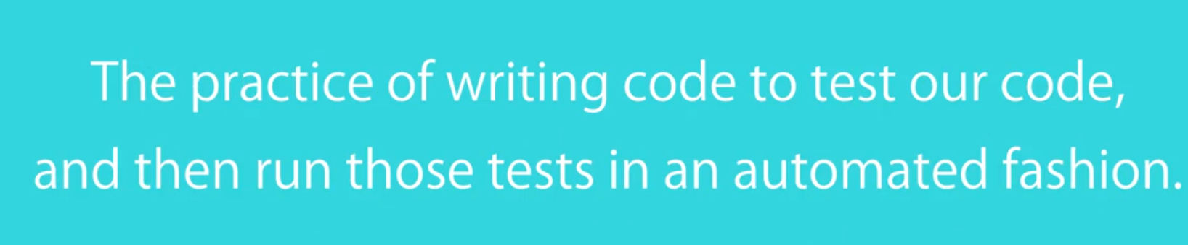

Slide 6
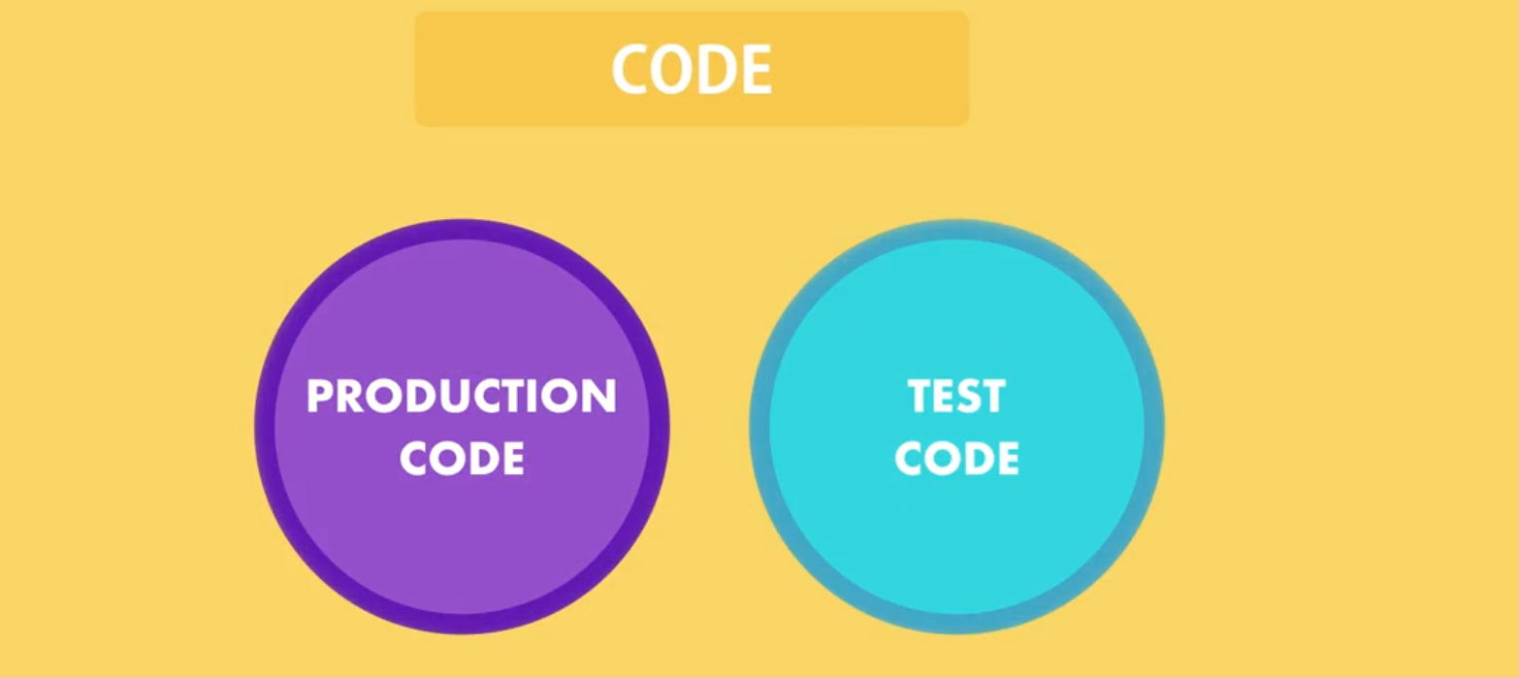

Slide 7

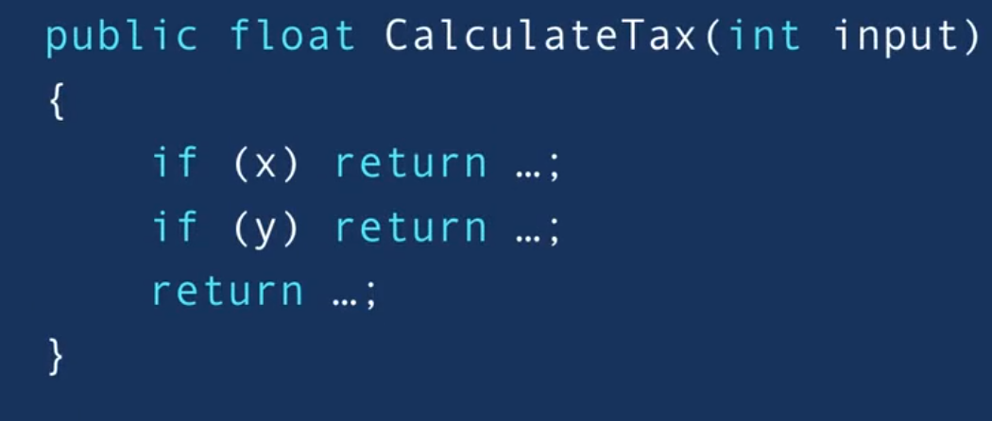


Slide 8
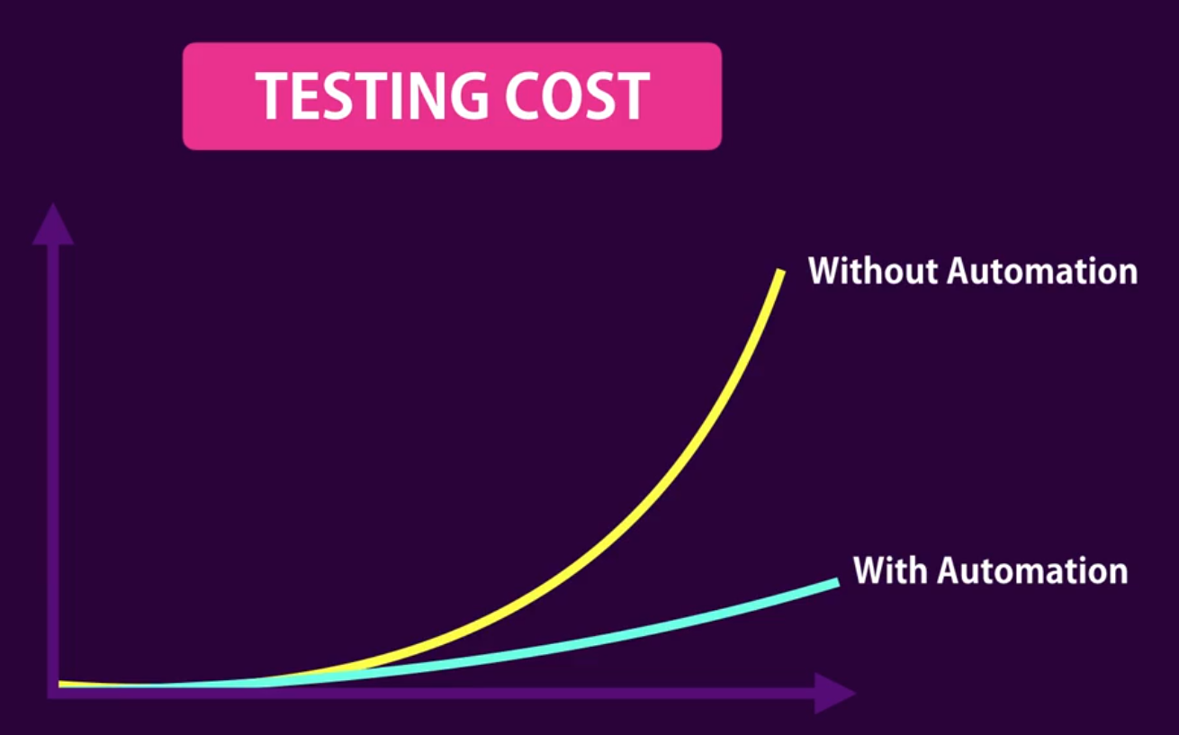

Slide 9

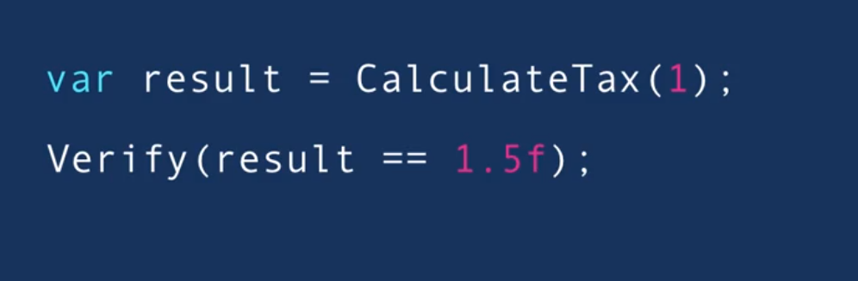
Notes:
Write Function and Verify the Result Right Away

Slide 10
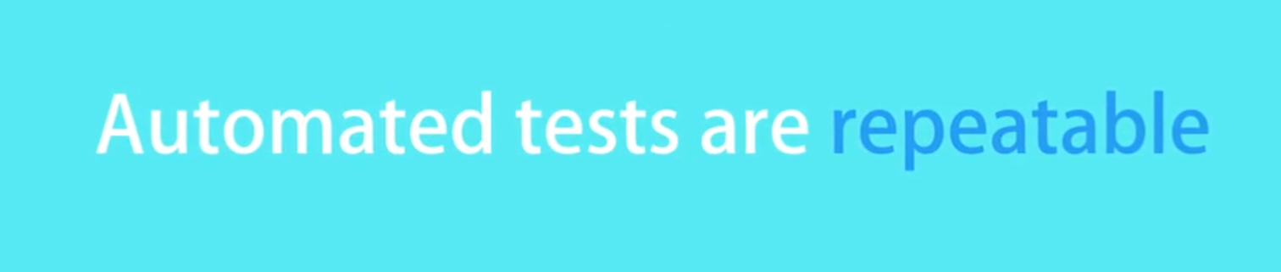

Slide 11
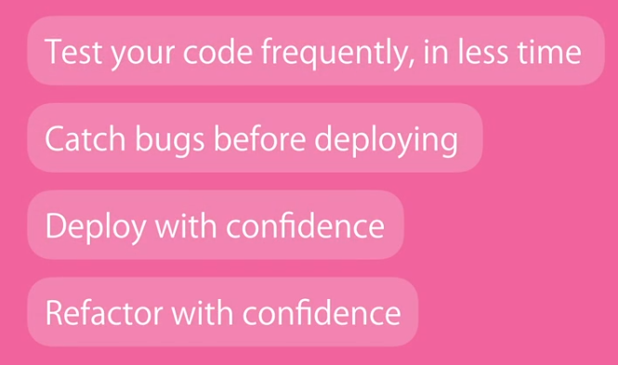


Slide 12
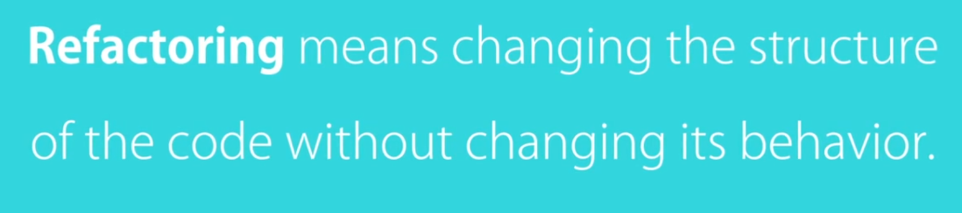

Slide 13

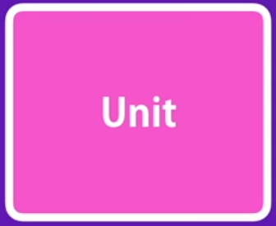
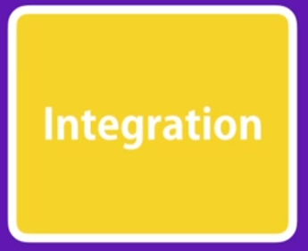
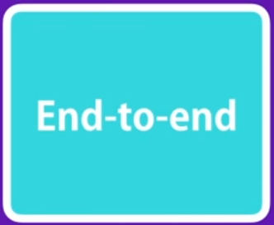

Slide 14

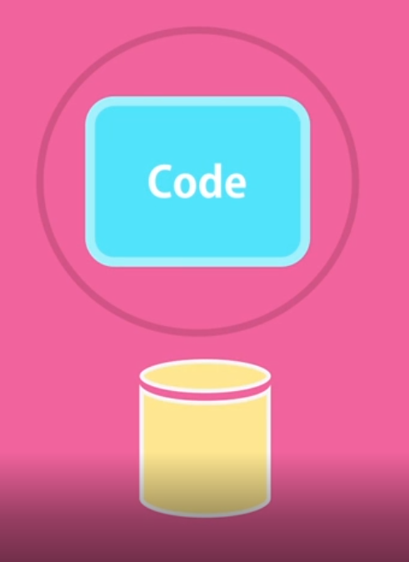





Slide 15

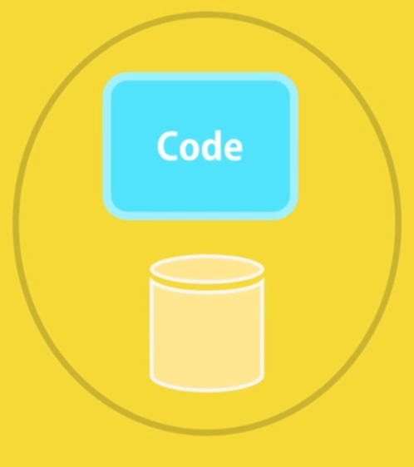
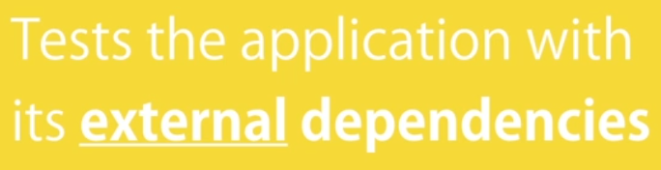



Slide 16







Slide 17
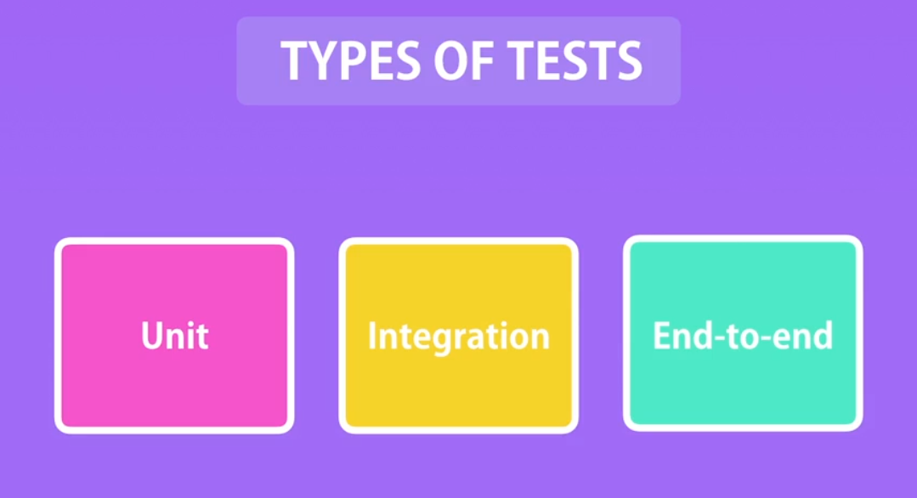

Slide 18

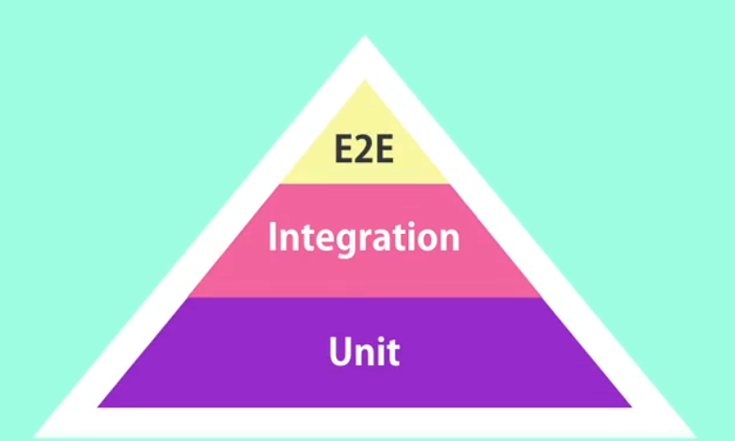

Slide 19


Slide 20




Slide 21
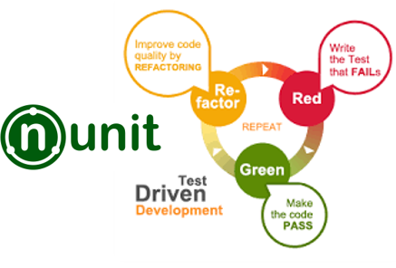
NUnit Testing Framework
NUnit is a unit-testing framework for .NET applications in which the entire application is isolated into diverse modules. Each module is tested independently to ensure that the objective is met. The NUnit Framework caters to a range of attributes that are used during unit tests. They are used to define Test -Fixtures, Test methods, ExpectedException, and Ignore methods.
NUnit Testing Framework
NUnit is a unit-testing framework for .NET applications
in which the entire application is isolated into
multiple modules.
They are used to define Test -Fixtures, Test methods, ExpectedException, and Ignore methods.

Slide 22
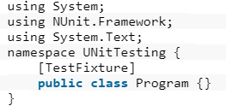
TextFixture Attribute
The TestFixture attribute is an indication that a class
contains test methods. When you mention this attribute
to a class in your project,
the Test Runner application will scan it for test methods.

Slide 23
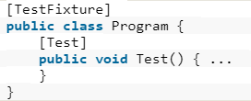
Test Attribute
The Test attribute indicates that a method
within a test fixture should be run by
the Test Runner application.
The method must be public, return void, and will not
be run when the Test Fixture is run.

Slide 24
Assert Class
the Assert class is used to confirm whether
the test cases are producing the expected result
or not using its auxiliary methods such as AreEqual() or AreNotEqual().

Slide 25
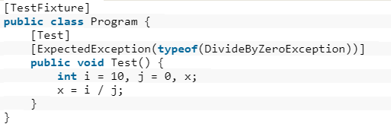
ExpectedException Attribute
You could fortify your code to handle various exceptions
by using try...Catch blocks. But sometimes you have some circumstances where you actually want to ensure that an exception occurs.

Slide 26
Ignore Attribute
The Ignore attribute is required to indicate
that a test should not be run on a particular method.

Slide 27
Notes:
- Installation

Slide 28
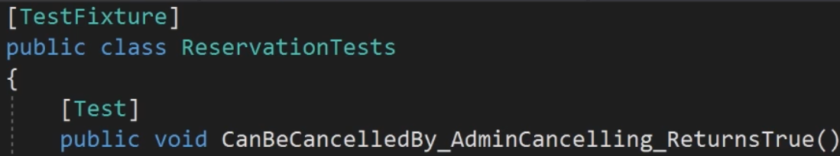
Notes:
Remove MSTest
Change Annotation

Slide 29
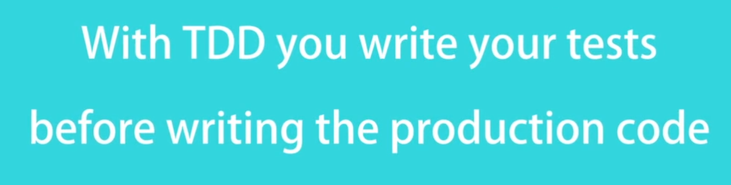

Slide 30





